Slide 1

Introduction to Machine Learning
Sidhidatri nayak
Cdac,noida

Slide 2

Objectives
What is data and its importance?
Data analytics
What Is Machine Learning?
Types of Machine Learning
How Machine Learning Works?
Machine Learning Use Cases

Slide 3


Slide 4
Types of data
Numerical data
Categorical data
Time-series data
Text data
Image data

Slide 5

Why is data important?
Data helps in make better decisions
Data helps in solve problems by finding the reason for underperformance
Data helps one to evaluate the performance.
Data helps one understand consumers and the market
Data helps one to predict future outcome

Slide 6
Data analysis
The process of examining, transforming, and arranging raw data in a specific way to generate useful information from it.
Analytical and logical reasoning to generate outcome or conclusion .
Involves a number of steps, approaches, and diverse techniques

Slide 7
Classification of Data analytics
Based on the phase of workflow and the kind of analysis required, there are four major types of data analytics.
Descriptive analytics
Diagnostic analytics
Predictive analytics
Prescriptive analytics

Slide 8
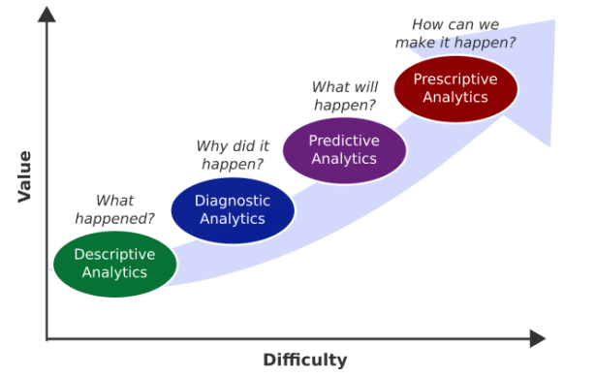
Classification of Data analytics

Slide 9
Types of learning
1. Batch Learning
2. Incremental learning
3. Instance based learning
4. Model based learning

Slide 10

What is AI/ML?
Artificial intelligence (AI) refers to the development of computer systems that mimic a human brain and enable them to perform tasks that usually require human intelligence.
Machine learning is a specific form of AI that allows computers to learn and grow after they are introduced to scenarios in the form of data.
Machine learning algorithms to perform tasks, you can feed them data (known as training data), which helps them make calculations, process data, and identify patterns automatically, in order to make their own predictions.
Ability to “self-learn” from training data and improve over time.
An automated process that enables machines to solve problems with little or no human input, and take actions based on past observations.

Slide 11
Applications of Machine learning
Social Media Analysis
Product Recommendations
Sentiment Analysis
Regulating Healthcare Efficiency and Medical Services
Banking Domain
Language Translation
customer segmentation
Traffic prediction
Virtual Personal Assistant
Email Spam and Malware Filtering:

Slide 12
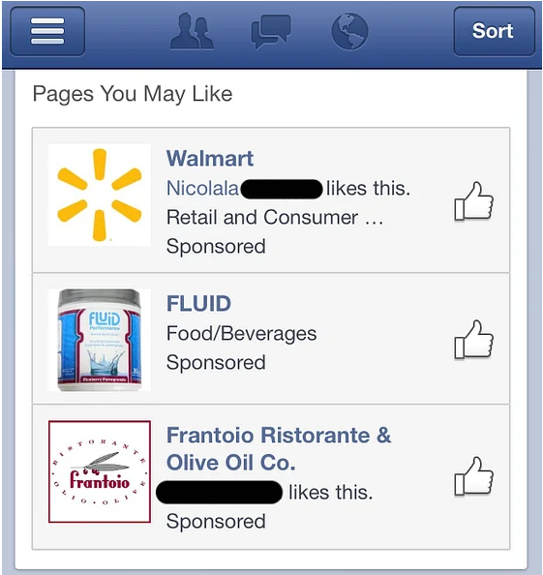
and

Slide 13

and

Slide 14
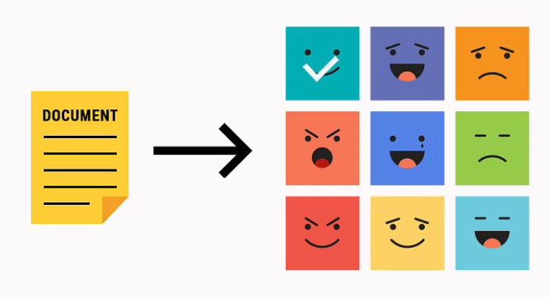
and

Slide 15
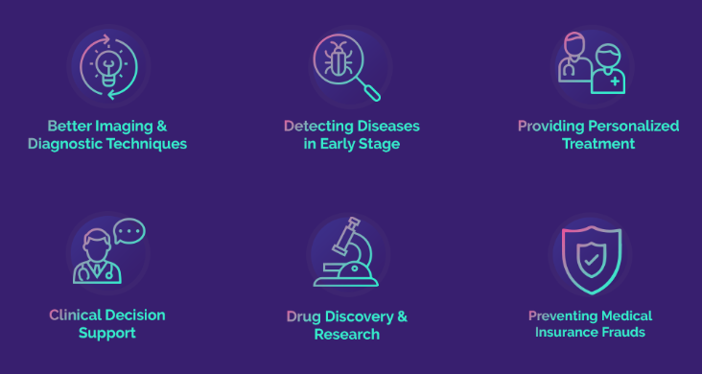
and

Slide 16
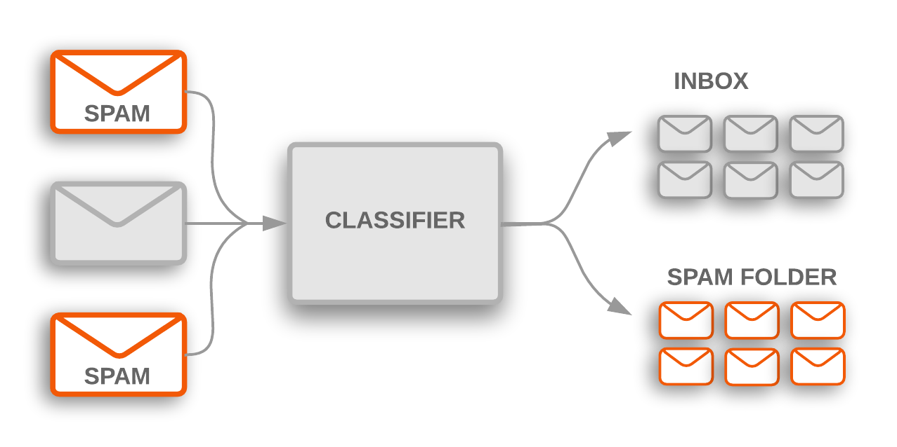
Example : spam filtering
and

Slide 17

and

Slide 18
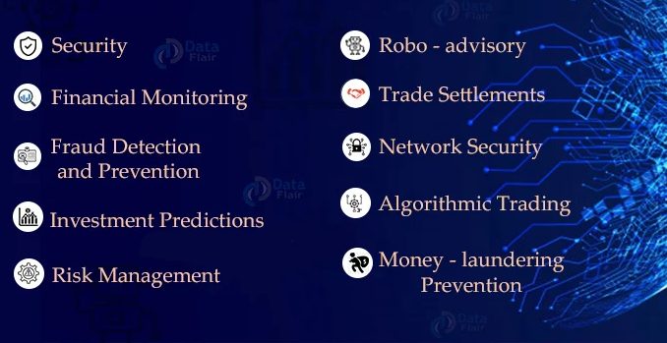
Machine learning in Finance
and

Slide 19
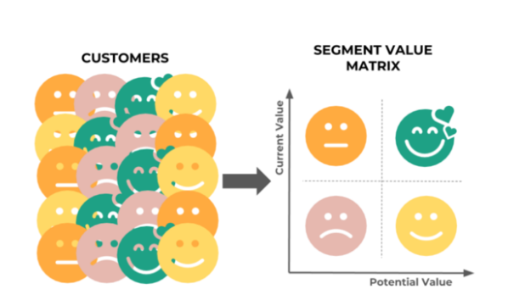
Customer segregation
and

Slide 20

Google Map using ML algorithm to predict the shortest path to your destination
and

Slide 21



Examples
Google; learn to
Learn to swim
Learn to code
Learn to surf
Alexa; what time it is
Its 10AM
ASAP
OMG
OMW
How about meet up for coffee in the evening
That’s good
Perfect
Not possible
and

Slide 22
How machine learning algorithm works?
Receive input data
Clean the data
Use statistical analysis and Machine learning models
Predict an output value within an acceptable range.
Evaluate the model to find the accuracy

Slide 23
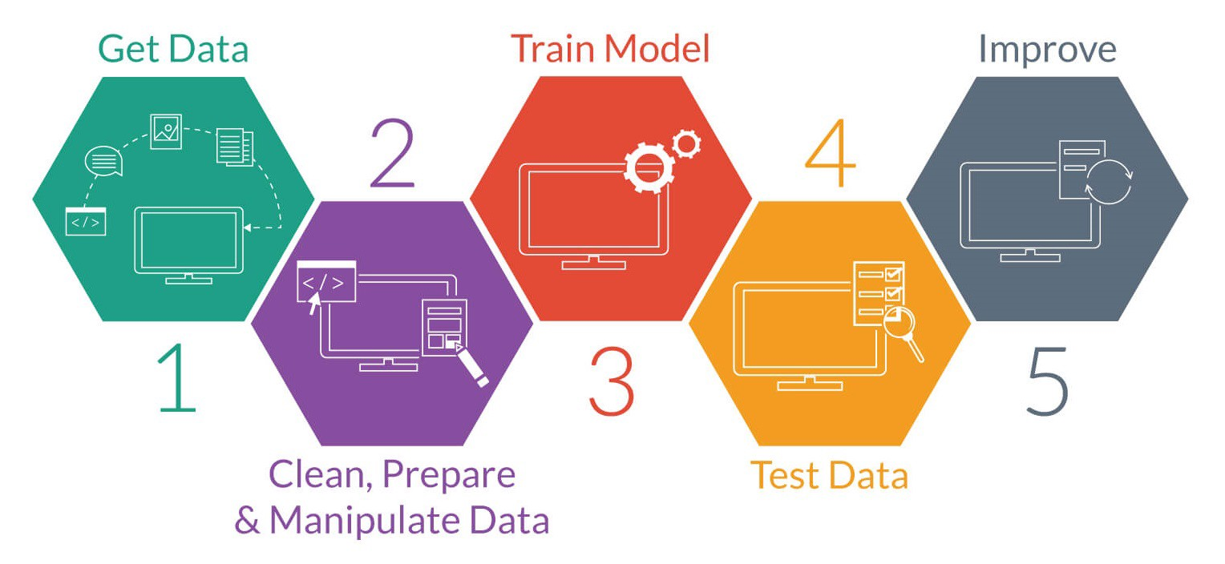
steps to follow
and

Slide 24
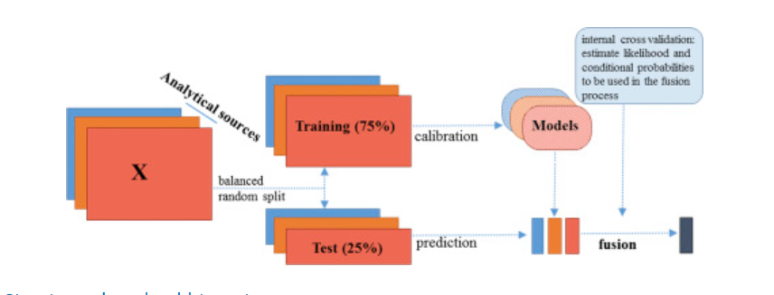
Train data and Test data

Slide 25
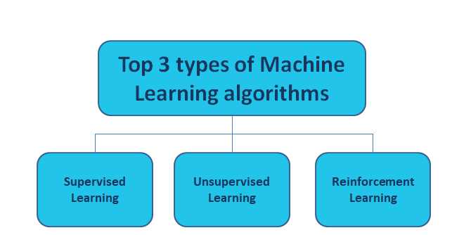

Slide 26
Supervised Algorithm
Machines are trained using well "labelled" training data.
The labelled data means some input data is already tagged with the correct output.
on basis of that data, machines predict the output.
In supervised learning, the training data provided to the machines work as the supervisor that teaches the machines to predict the output correctly. It applies the same concept as a student learns in the supervision of the teacher.
Supervised learning is a process of providing input data as well as correct output data to the machine learning model. The aim of a supervised learning algorithm is to find a mapping function to map the input variable(x) with the output variable(y).

Slide 27
Advantage of supervised algorithm
With the help of supervised learning, the model can predict the output on the basis of prior experiences.
In supervised learning, we can have an exact idea about the classes of objects.

Slide 28
Applications
In the real-world, supervised learning can be used for
Risk Assessment,
Image classification,
Fraud Detection,
spam filtering, etc.

Slide 29
Types of Supervised learning
Classification
Classification algorithms are used when the output variable is categorical, which means there are many classes such as Yes-No, Male-Female, True-false, etc.
K Nearest Neighbor
Decision Tree
Random Forest
Naive Bayes
Support Vector Machine
Regression
Regression algorithms are used if there is a relationship between the input variable and the output variable.
Linear regression
Multiple regression

Slide 30
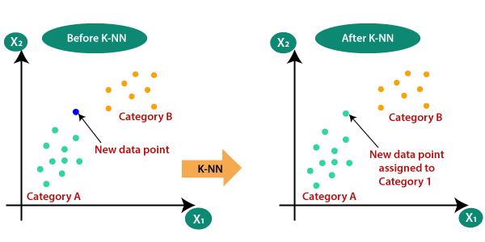
Classify the new data

Slide 31
Regression
regression is a supervised machine learning algorithm.
Statistical process of estimating the relationship among variables.
There are two types of variables .
Dependent variable , whose value is influenced or is to be predicted
Independent Variable, which influences the value and is used for prediction.
It shows the relationship between a dependent variable( regressed) and one or more independent variables(predictors/regressor)
The predictor is a continuous variable such as sales, salary, age, product price, etc.

Slide 32
Example
House 1 : x1: 1200sqft y1=200000
House 2 : x2: 1500sqft y2=300000
House 3 : x3: 1800sqft y3=400000
House 4 : x4: 2000sqft y4=500000
House 5: x5: 2200sqft y5=600000
Input( x1,x2,x3,x4,x5)
Output(y1,y2,y3,y4,y5)
The value of y can be predicted from x, the predictor variable.
Y variable is the quantity of interest.

Slide 33
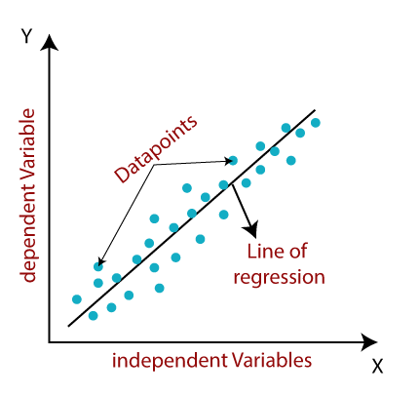

Slide 34
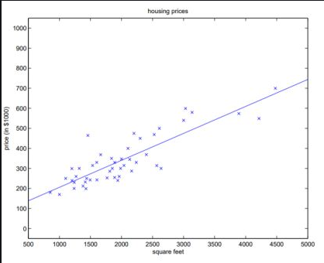
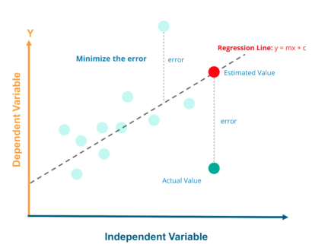
Regression Line

Slide 35
Applications of Regression
Predictive Analytics
Example:
Evaluating trend and sales estimate
Analyzing the impact of price changes
Assessment of risk in financial services and insurance domain

Slide 36
Regression Analysis
Regression Analysis is the process of developing a statistical model , to predict the value of dependent variable by at least one independent variable.

Slide 37
Difference between different ML types
 | Supervised | unsupervised | Reinforcement
Type of data | Labelled data | Unlabelled data | No – predefined data
Type of problems | Regression and classification | Clustering | Experience or Exploration
Supervision | Extra supervision | No supervision | No supervision
Algorithms | Linear Regression, Logistic Regression, SVM, KNN etc. | K – Means, C – Means, Apriori | Q – Learning, SARSA
Aim | Calculate outcomes | Discover underlying patterns | Learn a series of action
Application | Risk Evaluation, Forecast Sales | Recommendation System, customer segregation | Self Driving Cars, Gaming, Healthcare

Slide 38

Challenges in Machine learning
Bad data/algorithm
Data availability
Unnecessary features
Noisy data
Overfitting
underfitting

Slide 39

Thank You

